Slide 1
Pager Rotation Duties in DevOps: Best Practices
CSD 380 Jordany Gonzalez
February 11, 2025

Slide 2
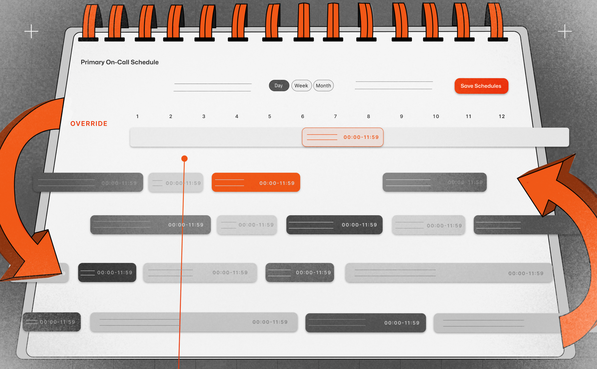
What is Pager Rotation? Why is it Important?
Pager rotation is the practice of assigning on-call responsibilities to team members to handle system alerts and incidents. This process is essential in ensuring system reliability and availability by enabling quick responses to operational issues. It also distributes responsibilities fairly across the team, preventing burnout and maintaining a sustainable workload. Effective pager rotation reduces downtime, improves incident resolution times, and fosters a culture of shared accountability. The objective of this presentation is to explore best practices for implementing an efficient and well-structured on-call duty rotation in a DevOps environment.

Slide 3


Key Principles of Pager Rotation
Fair and Equitable Distribution
No single individual should be overburdened.
Defined Escalation Policies
Clear guidelines on when and how to escalate unresolved issues.
Service-Level Agreements (SLAs)
Defined response and resolution times to maintain reliability.
Training and Documentation
Ensure all team members are well-prepared to handle incidents.

Slide 4



Industry Best Practices
Balance On-Call Shifts
Limit shifts to avoid excessive stress and fatigue.
Use Automation & Monitoring Tools
Reduce unnecessary alerts with proactive monitoring.
Post-Mortem Analysis
Conduct incident reviews to improve response strategies.
Clear Communication Protocols
Ensure team members are aligned with responsibilities and expectations.
Cross-Training Team Members
Prevent reliance on a single expert; ensure everyone is capable.

Slide 5





Tools and Technologies for Effective On-Call Management
Effective on-call management relies on several tools and technologies that streamline alerting, monitoring, and response coordination. Incident management platforms such as PagerDuty, Opsgenie, and VictorOps help centralize alerts and automate escalation workflows, ensuring prompt incident resolution. Logging and monitoring tools like Prometheus, Splunk, and Datadog provide real-time visibility into system performance, enabling teams to detect and address issues before they escalate. Collaboration tools such as Slack, Microsoft Teams, and Zoom facilitate rapid communication among on-call staff, allowing quick problem resolution and knowledge sharing. Additionally, automated alerting and escalation systems leverage AI-driven algorithms to minimize false positives and notify the appropriate personnel based on issue severity, reducing unnecessary disruptions and improving operational efficiency.

Slide 6
Handling Incident Escalations
Incident escalations are a crucial part of maintaining system reliability and ensuring that issues are addressed promptly. Without a clear escalation process, incidents may linger unresolved, leading to extended downtime and negative impacts on business operations. Handling escalations properly ensures that critical issues receive the attention they need and that they are directed to the right personnel who have the necessary expertise to resolve them efficiently.
Defined Severity Levels:
Categorizing issues (Critical, High, Medium, Low) helps teams prioritize incidents and allocate resources effectively, ensuring the most pressing problems are addressed first.
Escalation Pathways:
Establishing structured pathways ensures that unresolved incidents are quickly routed to the appropriate personnel, reducing delays in resolution.
Incident Documentation & Playbooks:
Having detailed playbooks and documentation allows responders to follow predefined steps, ensuring consistency and efficiency in incident handling, which minimizes errors and knowledge gaps.
Post-Incident Learning:
Conducting debriefs after major incidents helps refine response strategies, allowing teams to identify improvement areas and strengthen their approach to future escalations, fostering a culture of continuous learning and resilience.

Slide 7
Reducing Alert Fatigue
Alert fatigue can become a serious issue when on-call personnel are constantly bombarded with notifications, leading to stress, burnout, and reduced effectiveness in responding to critical incidents. When alerts are too frequent or unnecessary, team members may start ignoring or delaying responses, which can have severe consequences on system reliability and overall business operations. Preventing alert fatigue is essential to maintaining a high level of efficiency and effectiveness in incident response.
Set Intelligent Alert Thresholds
Minimizing false alarms by fine-tuning alert parameters helps prevent burnout and keeps on-call staff focused on legitimate issues.
Leverage AI & Machine Learning
Predicting failures before they occur allows teams to take preventative measures, reducing incident frequency and severity.
Encourage "Quiet Hours"
Reducing non-essential alerts during designated rest periods ensures better work-life balance for on-call personnel.
Analyze Alert Trends
Identifying recurring issues allows teams to address root causes rather than repeatedly responding to the same problems, improving long-term reliability.

Slide 8
Conclusion and References
Summary:
Pager rotation ensures system reliability and operational efficiency by structuring on-call duties effectively.
Best practices focus on fairness, automation, escalation management, and continuous improvement.
Final Thoughts:
A well-structured on-call process reduces burnout, enhances response times, and strengthens overall system stability.
References:
Yogesh. (2025, January 28). Best Practices for Managing On-Call Rotation (in 2025). AlertOps | Never Miss a Thing | Resolve Major IT Incidents & Automate Real-time Operations. https://alertops.com/on-call-rotation/
On-Call rotations and schedules | Articles | PagerDuty. (2023, January 17). PagerDuty. https://www.pagerduty.com/resources/learn/call-rotations-schedules/
Kim, G., Debois, P., Willis, J., & Humble, J. (2016). The DevOps Handbook: How to Create World-Class Agility, Reliability, and Security in Technology Organizations. https://dl.acm.org/citation.cfm?id=3044729

